Slide 1
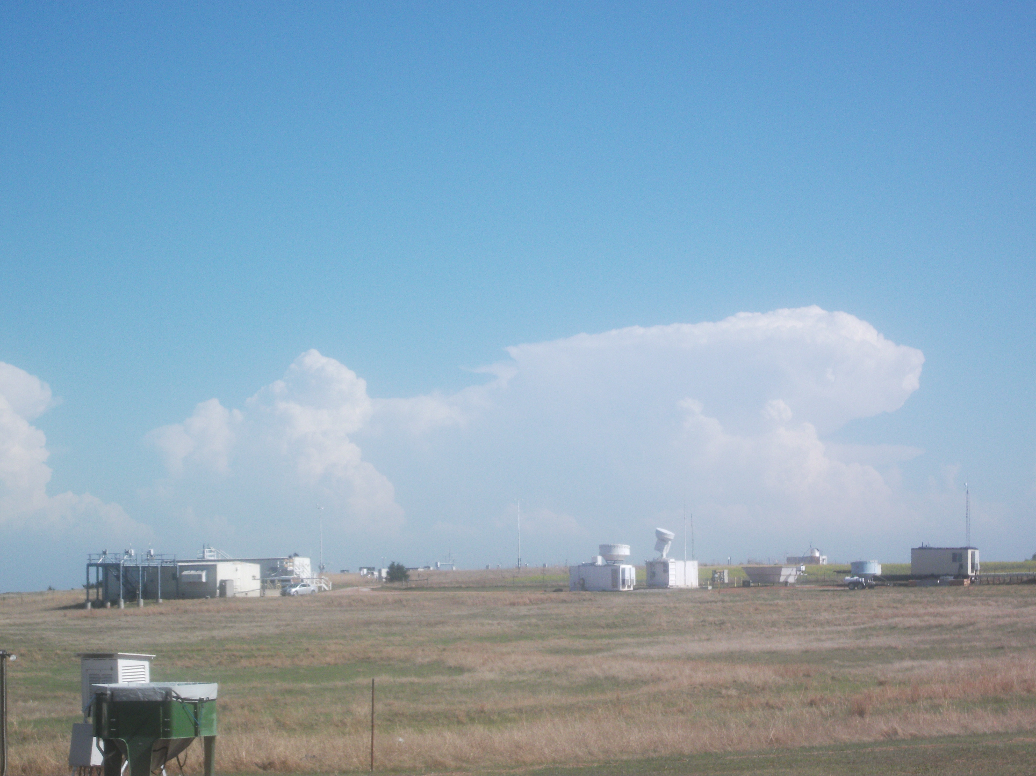
The Dependence of Cloud Size Distributions and Bulk Parameters Measured during MC3E on Environmental Conditions
Greg McFarquhar, Will Wu and the MC3E team
University of Illinois
ASR Fall Meeting 4 November 2003

Slide 2
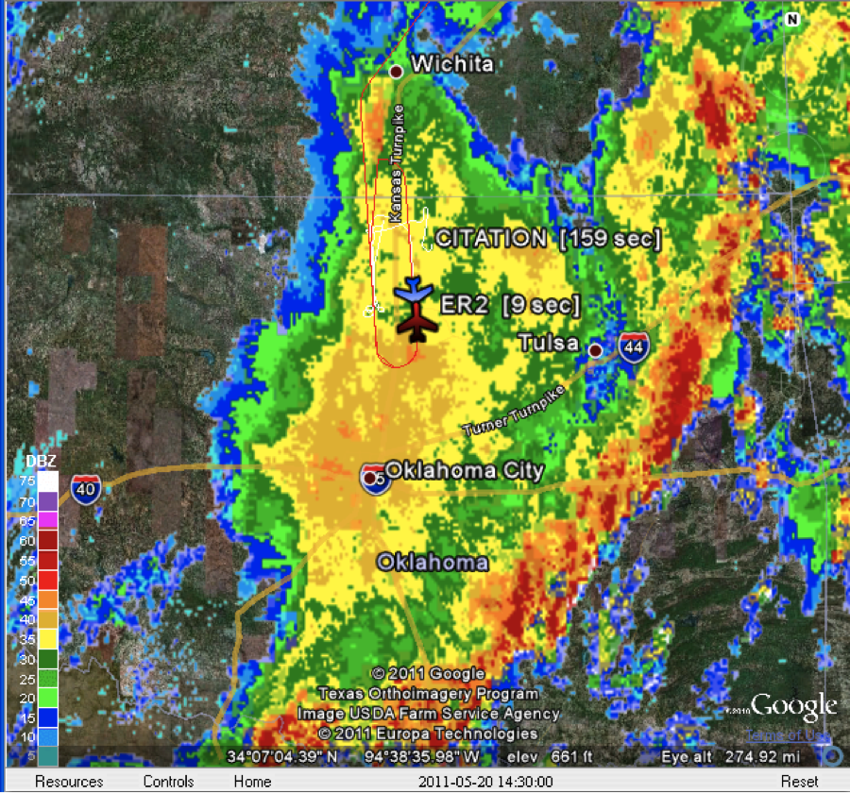
May 20 Case

Slide 3
May 20 Case

Slide 4
CIP Processing
Corrected timing drift problem
Holroyd habit classification and Jackson et al. (2012) m-D relationship for mass calculation (also computed m-D from Baker/Lawson 2006)
Shattering effect removal using inter-arrival information
Used particle reconstruction for images touching edges of photodiode array
Output area ratio, aspect ratio and more single particle properties

Slide 5
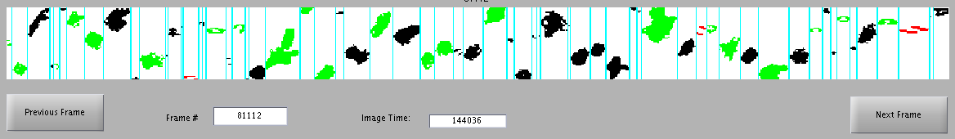
Example CIP Size/Shape Distribution
N(D) [m⁻³ μm⁻¹]
D [μm]

Slide 6
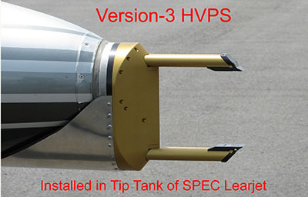
Integrate HVPS3 data into analysis
128 diodes
2DS electronics.
150 um resolution
High sample volume
Particles from 150 um-1.9 cm

Slide 7
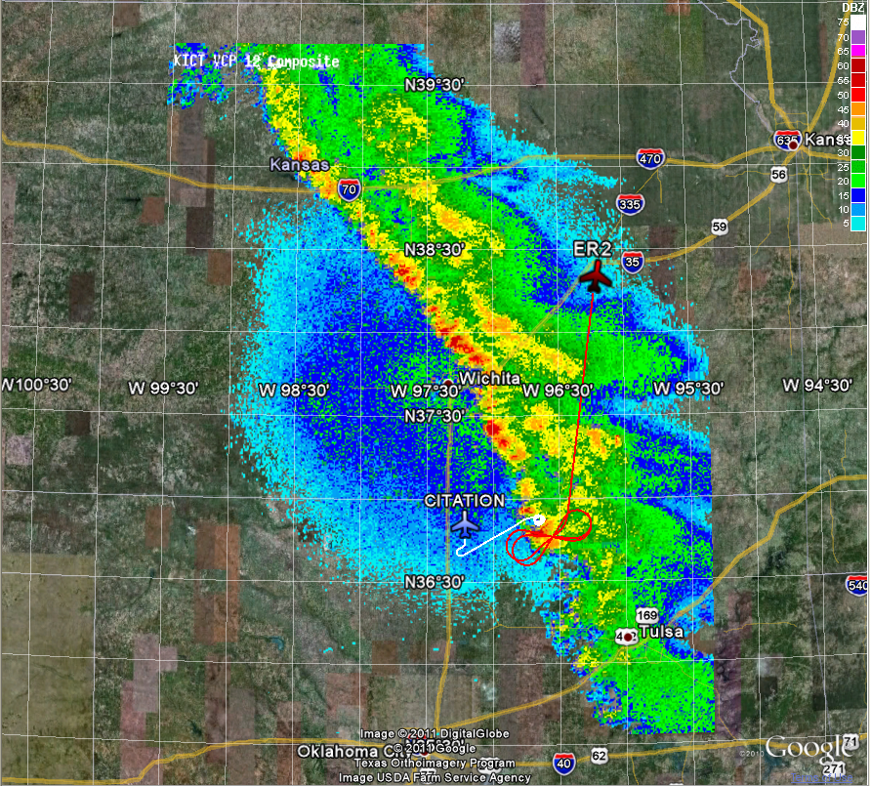
May 18:
Squall line extending from low pressure system in Colorado, moisture from Gulf Stream

Slide 8
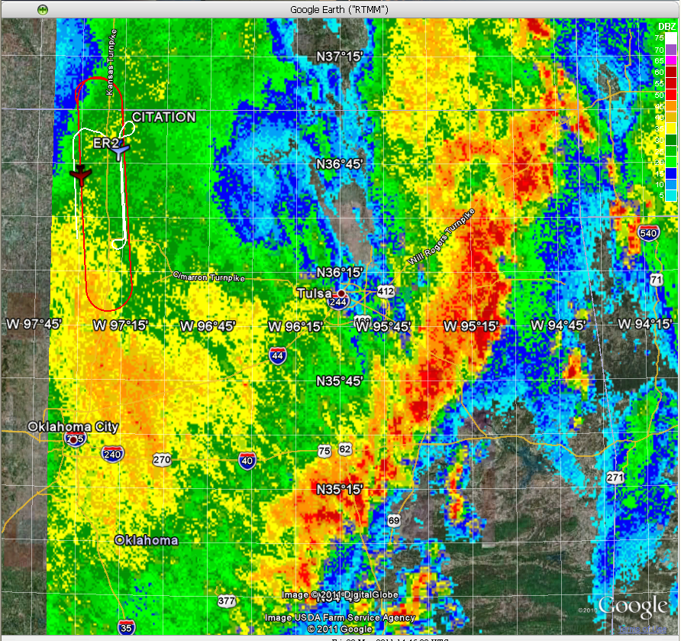
May 20:
Strong low-level jet pushed over OK in early morning as a deep trough moved through western US; large MCS formed just west of cold front

Slide 9
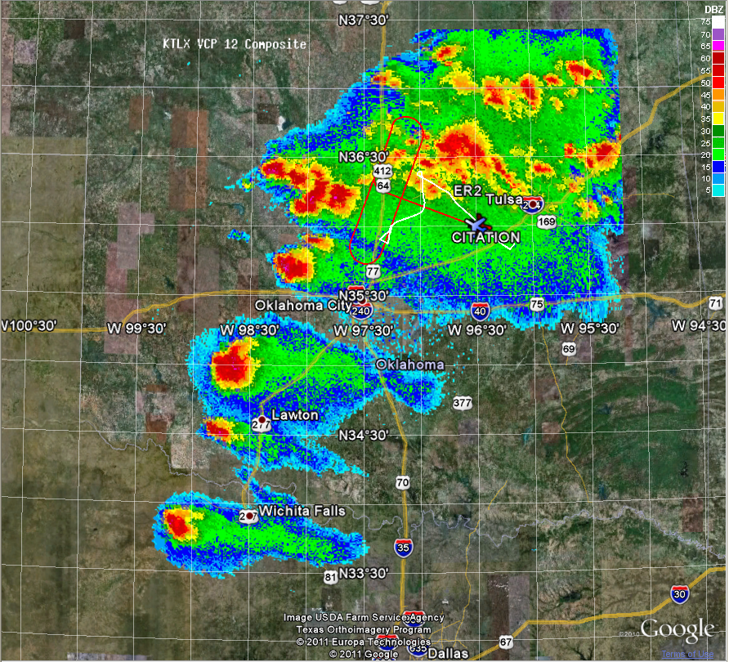
May 23:
Surface low pushed into OK panhandle, interacting with dry line and firing convection; several cells along dry line became supercells

Slide 10
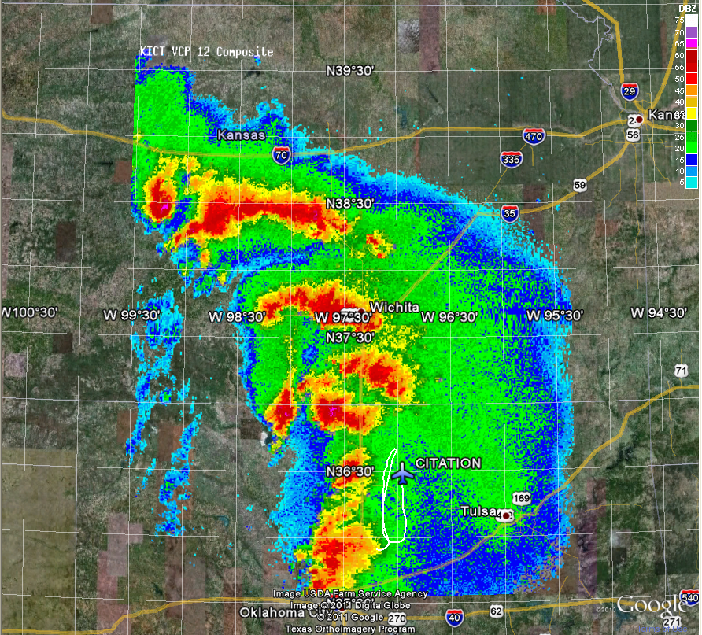
May 24:
Upper level trough over Rockies and surface low over OK pushed dry line to western part of state, where cells firing in N-S line intensified into super cells generating some tornadoes

